Slide 1




Terrorism Attack Data Analysis
View in Power BI
Swarnalatha Sethuraman

Slide 2
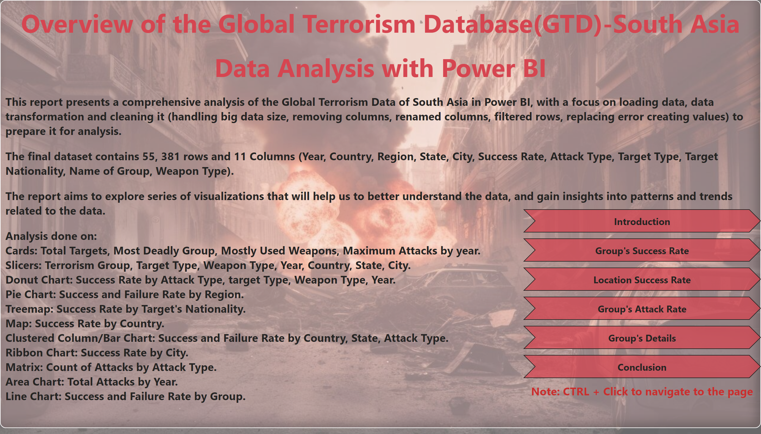
Dashboard
Notes:
textbox
No alt text provided
pageNavigator
No alt text provided
textbox
No alt text provided

Slide 3
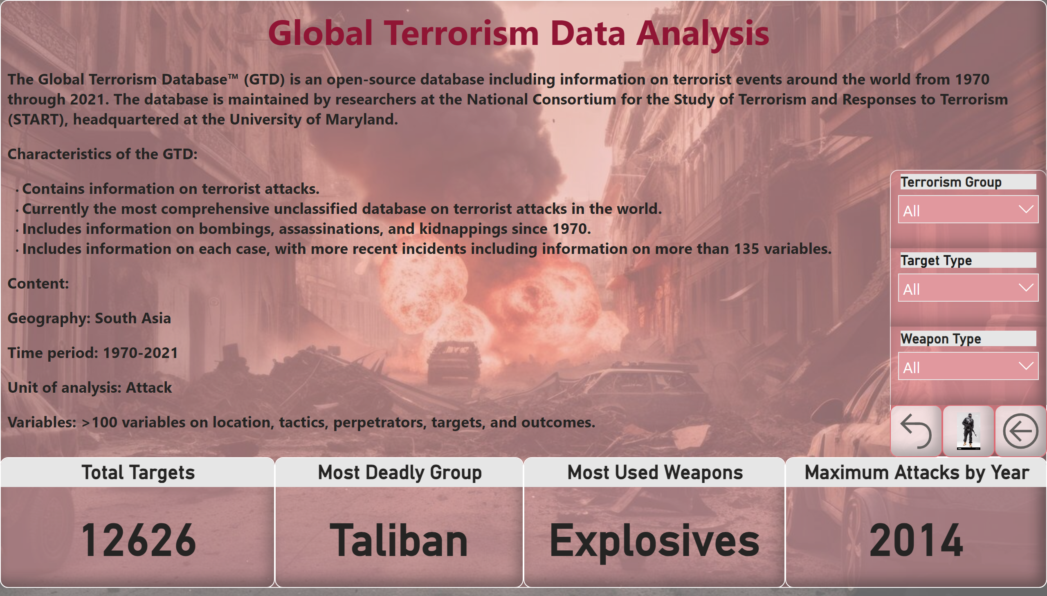
Introduction
Notes:
textbox
No alt text provided
Total Targets
No alt text provided
Most Used Weapons
No alt text provided
Most Deadly Group
No alt text provided
Maximum Attacks by Year
No alt text provided
textbox
No alt text provided
slicer
No alt text provided
slicer
No alt text provided
slicer
No alt text provided
image
No alt text provided
actionButton
No alt text provided
actionButton
No alt text provided

Slide 4
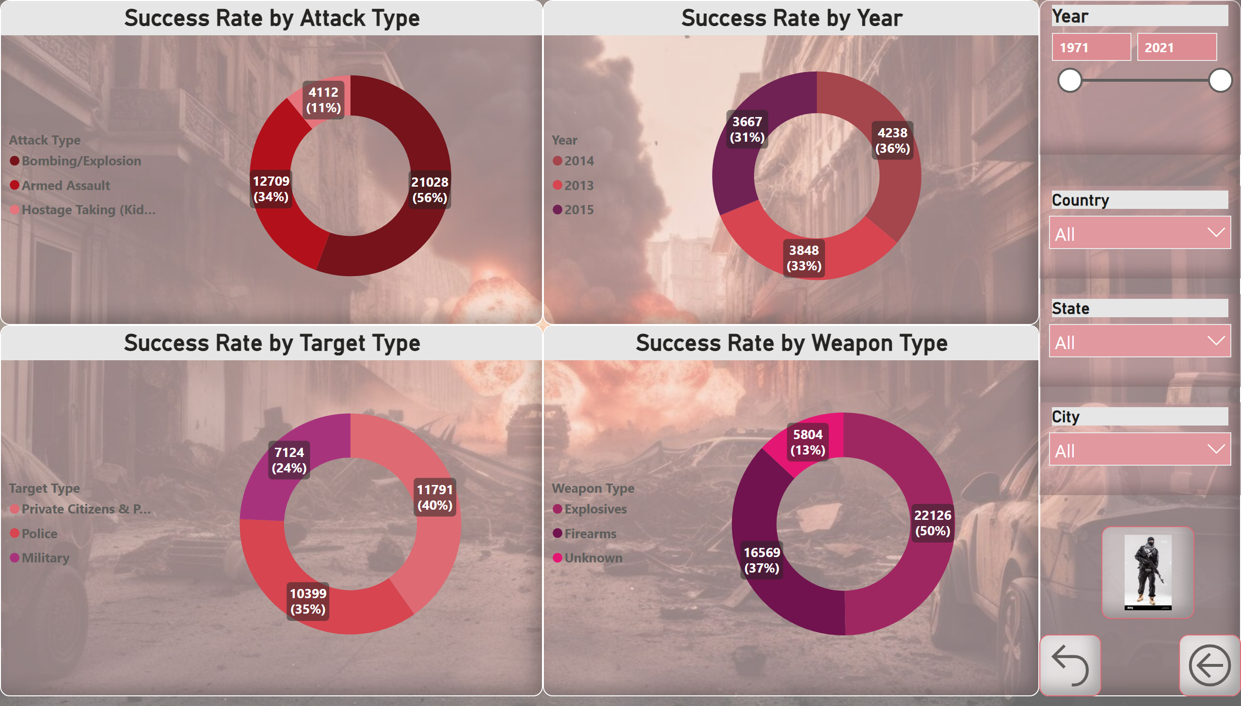
Group's Success Rate
Notes:
Success Rate by Attack Type
No alt text provided
Success Rate by Target Type
No alt text provided
Success Rate by Weapon Type
No alt text provided
textbox
No alt text provided
Success Rate by Year
No alt text provided
slicer
No alt text provided
slicer
No alt text provided
slicer
No alt text provided
slicer
No alt text provided
actionButton
No alt text provided
actionButton
No alt text provided
image
No alt text provided

Slide 5
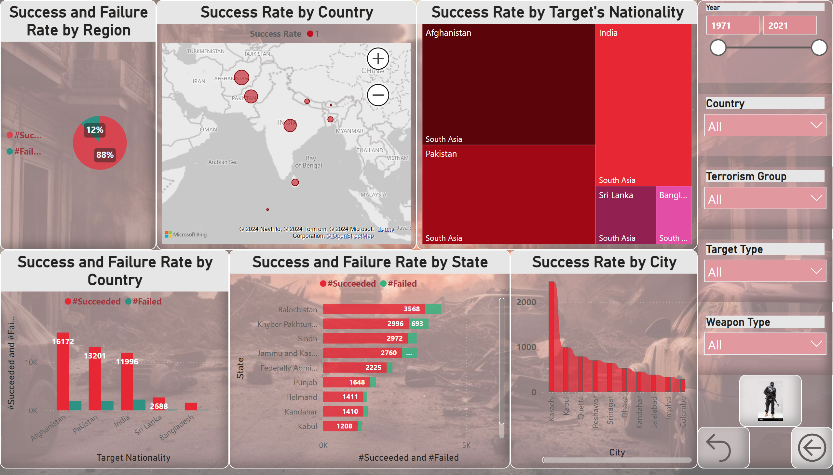
Location Success Rate
Notes:
textbox
No alt text provided
slicer
No alt text provided
slicer
No alt text provided
actionButton
No alt text provided
actionButton
No alt text provided
image
No alt text provided
Success Rate by Country
No alt text provided
slicer
No alt text provided
slicer
No alt text provided
slicer
No alt text provided
Success and Failure Rate by Region
No alt text provided
Success and Failure Rate by Country
No alt text provided
Success Rate by Target's Nationality
No alt text provided
Success and Failure Rate by State
No alt text provided
Success Rate by City
No alt text provided

Slide 6
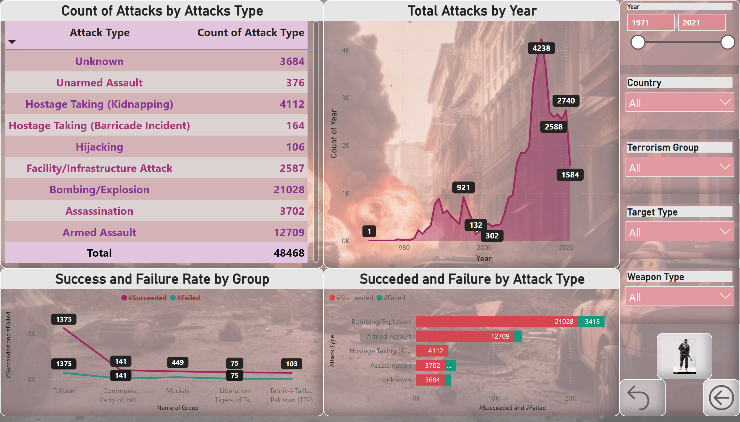
Group's Attack Rate
Notes:
textbox
No alt text provided
slicer
No alt text provided
slicer
No alt text provided
actionButton
No alt text provided
actionButton
No alt text provided
image
No alt text provided
slicer
No alt text provided
slicer
No alt text provided
slicer
No alt text provided
Total Attacks by Year
No alt text provided
Success and Failure Rate by Group
No alt text provided
Count of Attacks by Attacks Type
No alt text provided
Succeded and Failure by Attack Type
No alt text provided

Slide 7
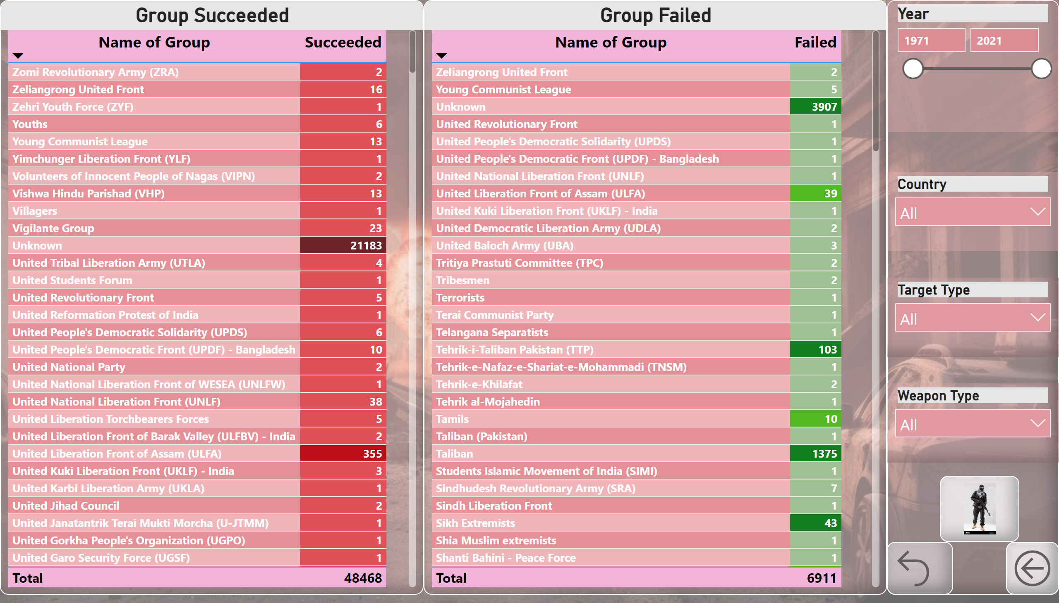
Group's Details
Notes:
textbox
No alt text provided
slicer
No alt text provided
slicer
No alt text provided
actionButton
No alt text provided
actionButton
No alt text provided
image
No alt text provided
slicer
No alt text provided
slicer
No alt text provided
Group Succeeded
No alt text provided
Group Failed
No alt text provided

Slide 8
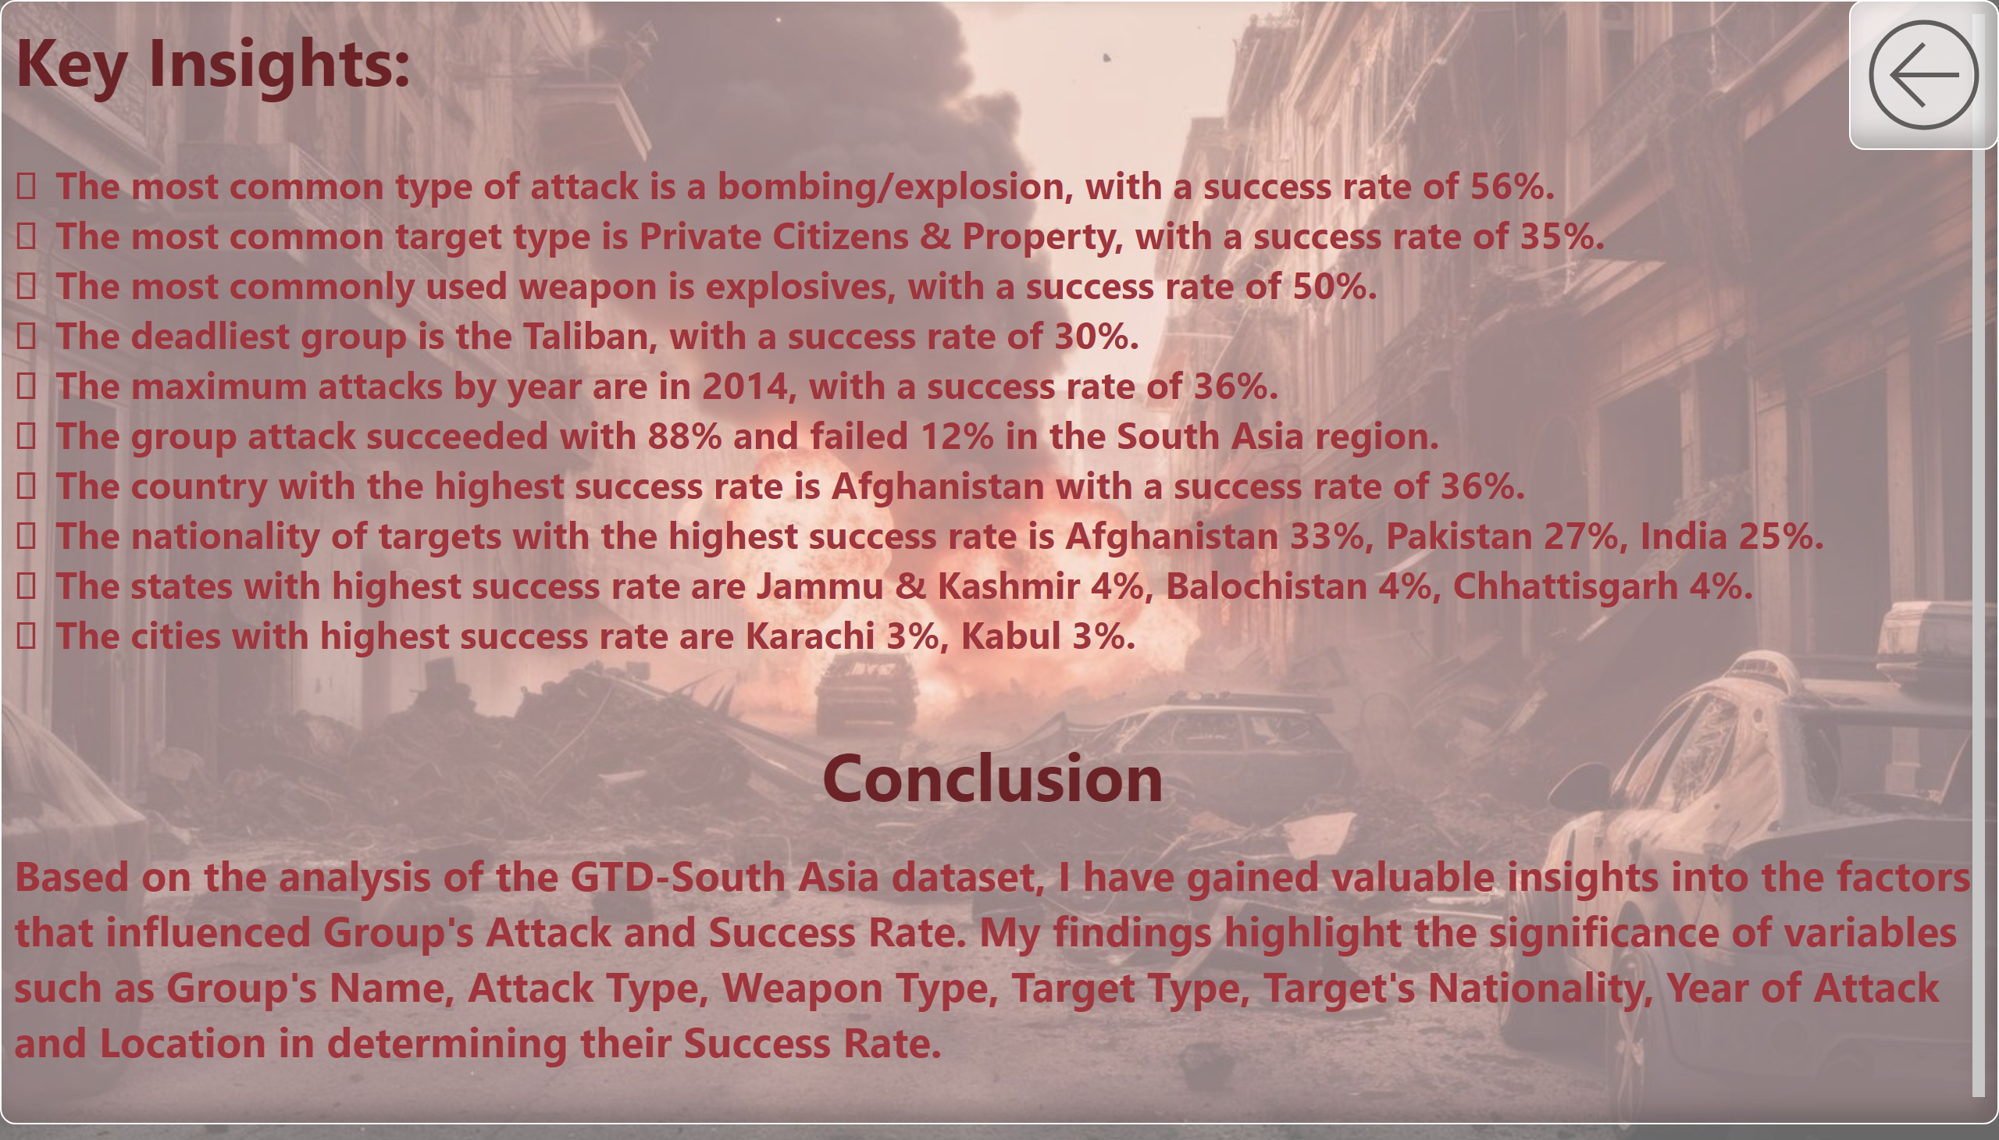
Conclusion
Notes:
textbox
No alt text provided
actionButton
No alt text provided

